Slide 1
לפני שמתחילים
השקף שהבטחתי בשיעור שעבר
(ותודה ללאה שהזכירה לי)
הסבר למתקדמים על תמונות בצבע!
https://www.youtube.com/watch?v=syJo37AKaro

Slide 2
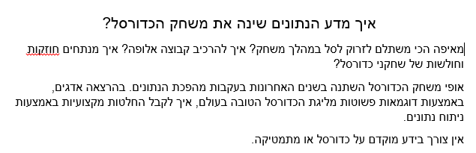
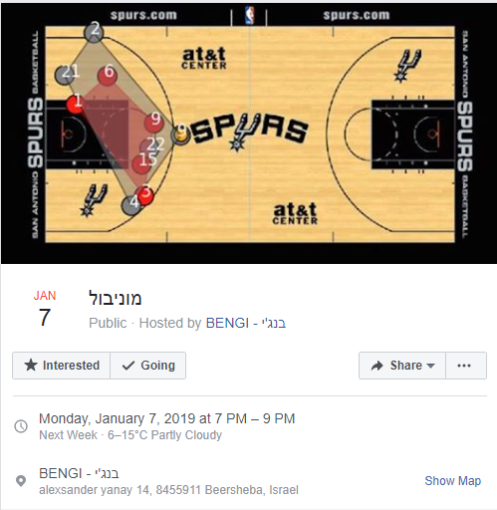
פרסומת..
https://www.facebook.com/events/737631259940911/

Slide 3
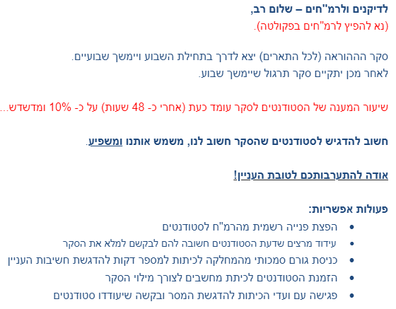
הודעה אחרונה

Slide 4

Introduction to programming in Python
Fall 2018-19
Department of Software and Information Systems Engineering
Ben-Gurion University of the Negev
Lecture 22: Images: representation and processing

Slide 5
Last time
Higher order functions
Image representation (just started)

Slide 6
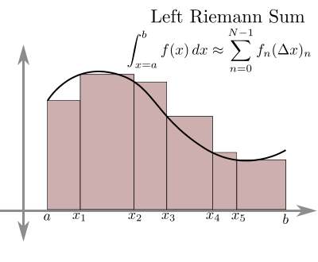
Computing integrals with Riemann sums
http://calculus.seas.upenn.edu/?n=Main.DiscreteIntegration

Slide 7
The Integral as a High Order Function
def integral(f, h=0.001):
""" definite integral: function of a, b """
return lambda a,b: \
h * sum(f(a+i*h) \
for i in range(0, int((b-a)/h )))
def square(x):
return x**2
>>> integral(square)(0 ,1)
0.33283349999999995 # should be (1**3)/3=0.33333
>>> integral(diff(square))(0 ,2)
3.9999999999996643 # should be 2**2

Slide 8
Lecture 21-22 Plan
Introduction to Digital Image representation.
Grayscale and color image
Bit depth, resolution
Class Matrix
Generating synthetic images
Basics of Digital Image Processing
Noise, and local noise reductions

Slide 9
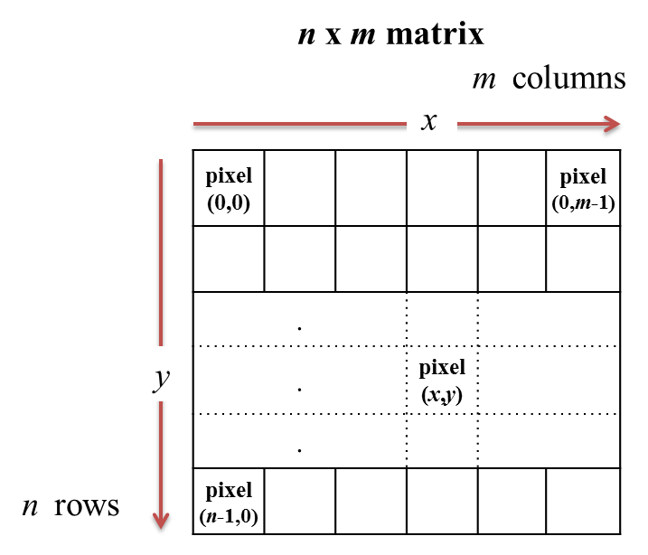
Basic model of a digital image

Slide 10
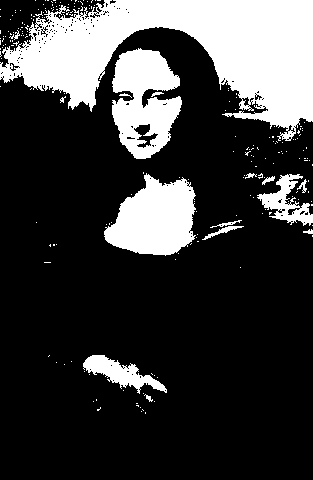
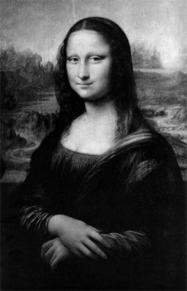
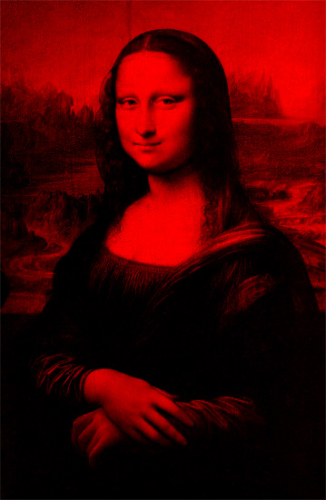
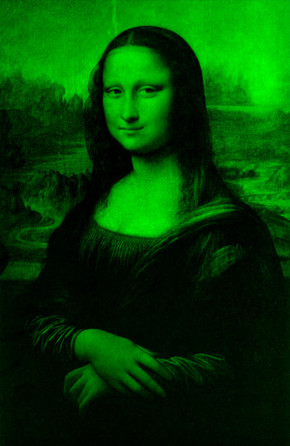
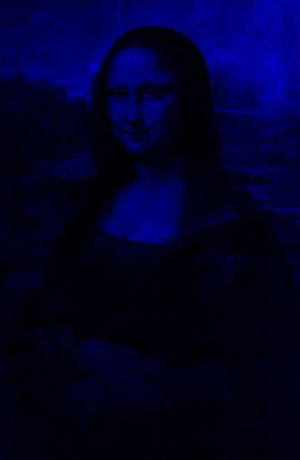
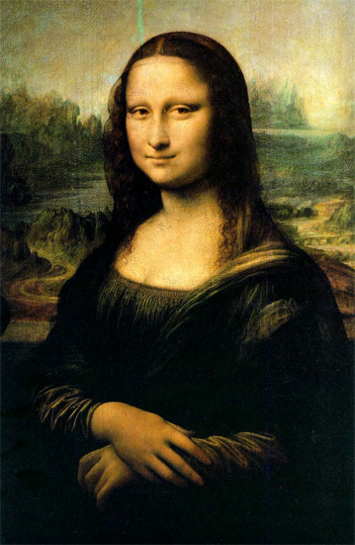
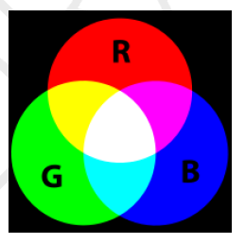
Color images
Black & white
(1 bpp)
256 gray level image
(8 bpp)
Images from: http://www.csse.uwa.edu.au/~wongt/matlab.html
"true color" image
(8+8+8 = 24 bpp)
Notes:
10

Slide 11
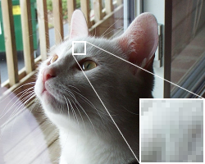
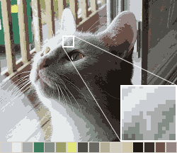
Image Quantization
Number of bits per pixel
24 bit RGB
16 colors
Note that both images have the same pixel & spatial resolution
Notes:
11

Slide 12
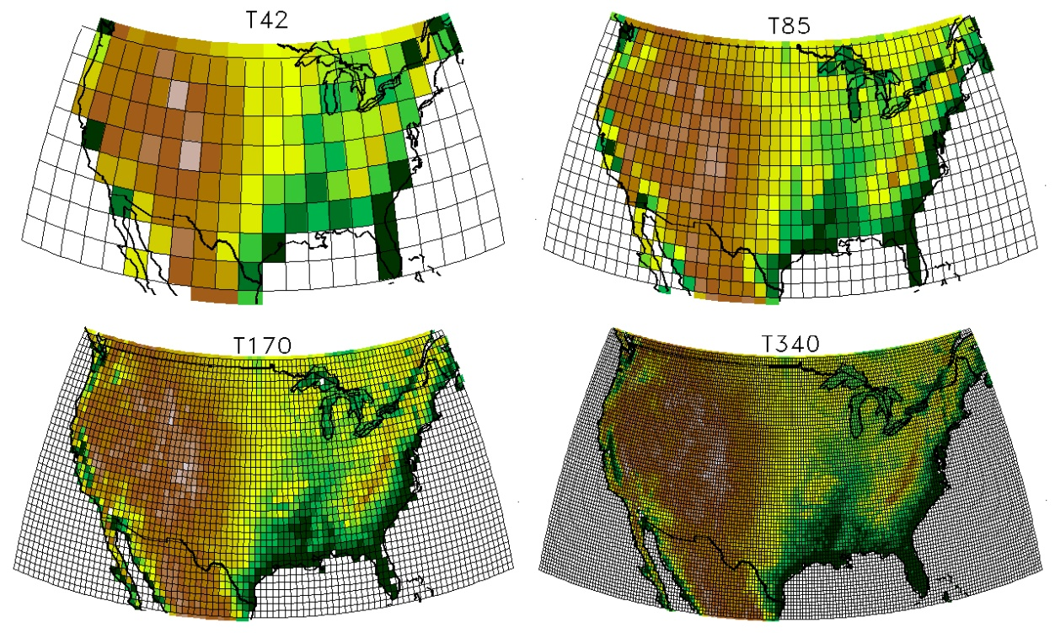
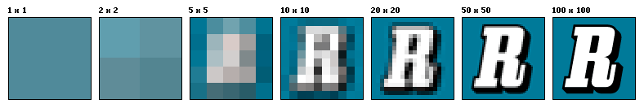
Resolution
Resolution is the capability of the sensor to observe or measure the smallest object clearly with distinct boundaries.
Resolution depends on the physical size of a pixel.
Higher resolution = more pixels per area = lower pixel size.
Source: wikipedia
Notes:
12

Slide 13
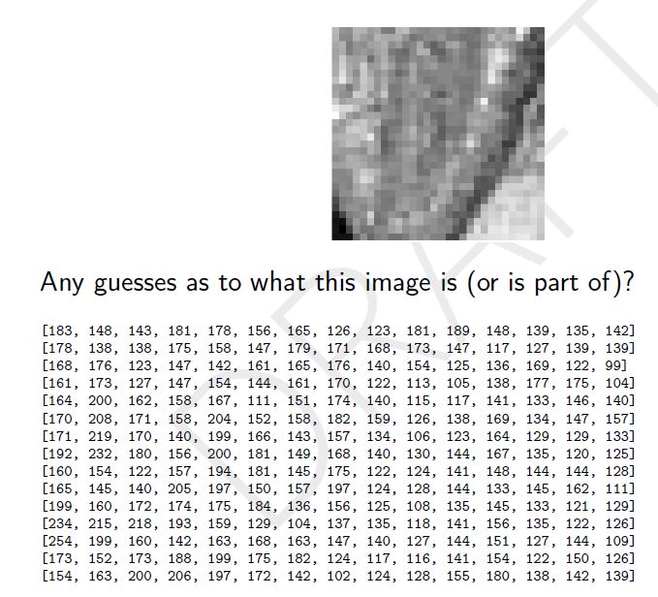
An image
13
Notes:
13

Slide 14
Our implementation: The Class Matrix
Class Matrix, implemented as a list of lists:
class Matrix: def __init__(self, n, m, val=0): assert n > 0 and m > 0 self.rows = [[val]*m for i in range(n)]
fill
with val

Slide 15
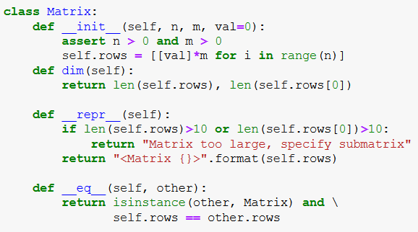
The Class Matrix (2)
calls eq
of class list

Slide 16
The Class Matrix (3)
Additional methods (we will only show how to use them):
copy
Arithmetical operations, e.g., mat1 + mat2
__getitem__ : receives a tuple (i,j)
__setitem__ : receives a tuple (i,j) and val
i and j can be both integers or both slices
display: shows the image represented by a matrix, uses the Python standard (no installation needed) package tkinter
save and load: enable storing and reading images from files

Slide 17
class Matrix - item access and assignment
>>> m = Matrix(10, 10) # 10x10 matrix of zeros
>>> m[4,5] # same as m.__getitem__((4,5))
0
>>> m[4,5] = 45 # same as m.__setitem__((4,5),45)
>>> m[4,5]
45
Note: the code file contains an additional feature: accessing and assignment of a whole slice.
>>> m[3:5, 4:8] # here i and j are both slices
<Matrix [[0 , 0, 0, 0], [0, 45, 0, 0]] >

Slide 18
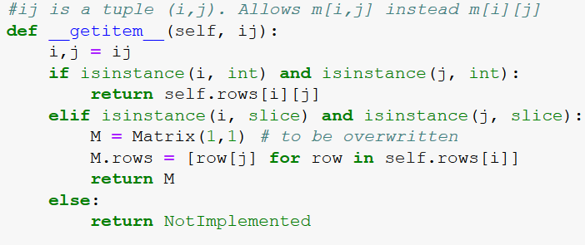
class Matrix - Indexing
# cell/sub-matrix access/assignment ####################################
both ints
both slices
int & slice

Slide 19
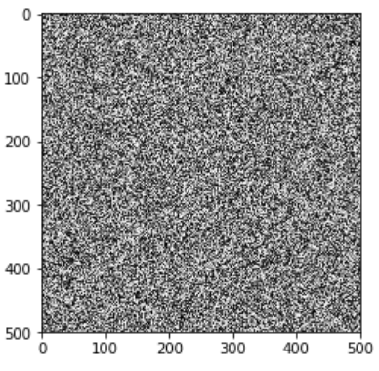
Displaying an image
n = 500
m = 500
mat = Matrix(n,m)
for i in range(n):
for j in range(m):
mat[i,j] = random.randint(0,255)
>>> mat
Matrix too large, specify submatrix
>>> mat[3:5, 4:8]
<Matrix [[216, 213, 114, 208], [2, 4, 245, 149]]>
>>> mat.display()

Slide 20
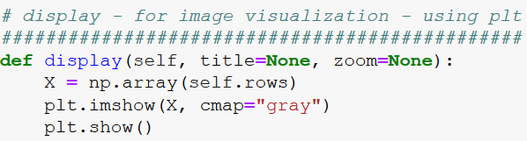
Display image

Slide 21
save to and load from file
>>> mat.save("./rand_image.bitmap")
A new file rand_image.bitmap will be created.
Although we gave it the extension .bitmap, this is merely a text file:
>>> mat2 = Matrix.load("./rand_image.bitmap")
rand_image.bitmap
500 500
230 168 178 213 28 159 121 …
222 133 165 152 8 236 188 …
51 152 152 93 120 117 208 …
…

Slide 22
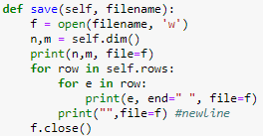
save image to file
rand_image.bitmap
Note: save and load should follow the exact same format

Slide 23
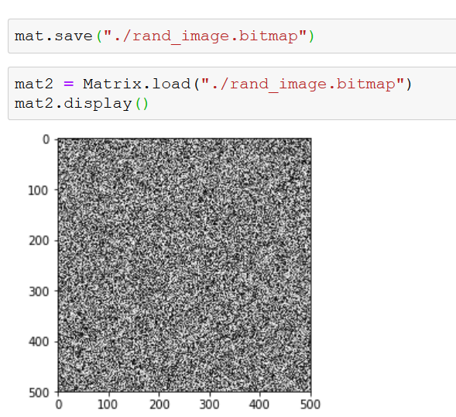
Using save and load
same as before

Slide 24
A few issues to discuss regarding image representation
“Translating” our custom .bitmap format to standard image formats in next slide (which I’ll be skipping today)
Any suggestions on how to improve the inner representation of an image?
Of course there are existing Python libraries with image (and image processing) functionalities, https://scikit-image.org/

Slide 25
from "real" image formats to .bitmap
we provide a way to work with "real" images in known formats such as jpg, bmp, tif etc.
The file format_conversion.py contains the transformation in both directions.
To have it work, you first need to install an external Python package called PILLOW – Python Imaging Library, from: https://pypi.python.org/pypi/Pillow
>>> image2bitmap("./an_image.jpg") #creates an_image.bitmap
>>> bitmap2image("./an_image.bitmap") #vice versa
Note: You do NOT need to understand the image2bitmap and bitmap2image methods

Slide 26
Generating simple synthetic images

Slide 27
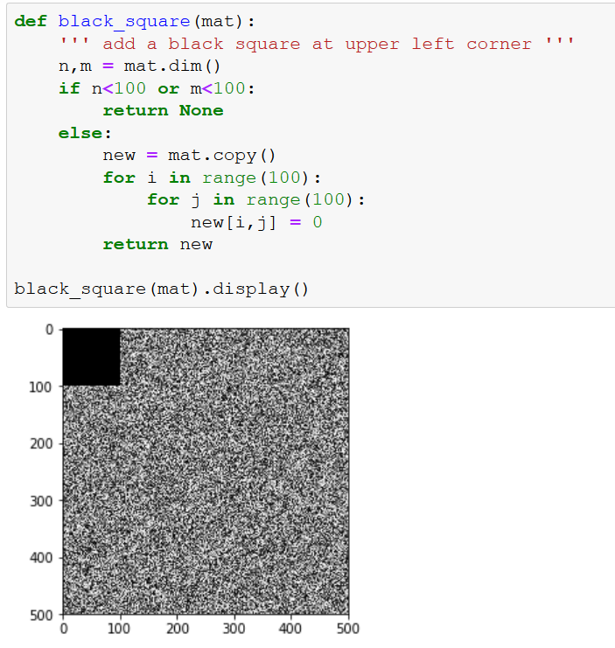
Drawing a black square
Would be nice to have numpy arrays here..

Slide 28
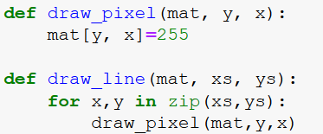
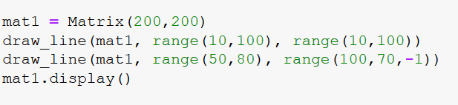
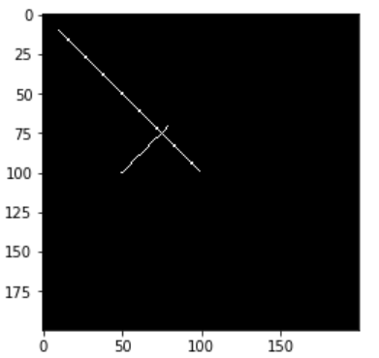
Drawing points and lines

Slide 29
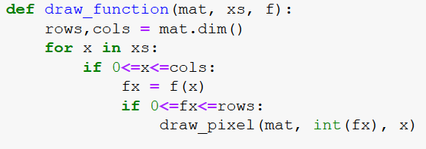
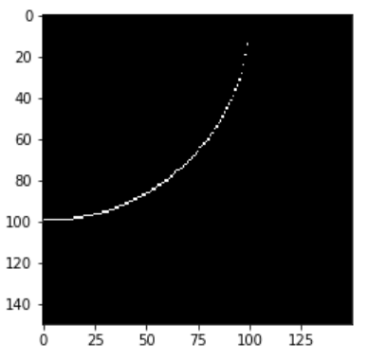
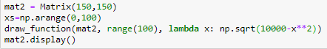
Drawing a Function

Slide 30
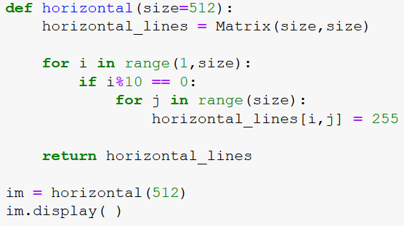

Horizontal lines

Slide 31
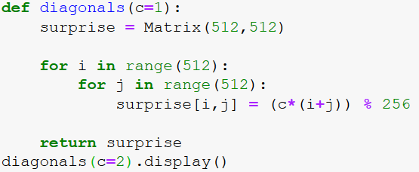
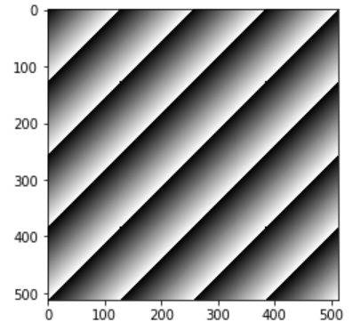
Diagonal lines

Slide 32
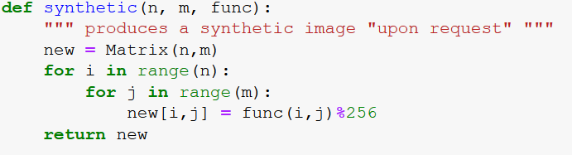
Functions as arguments

Slide 33
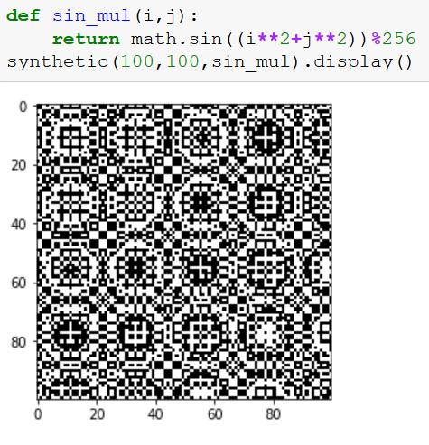
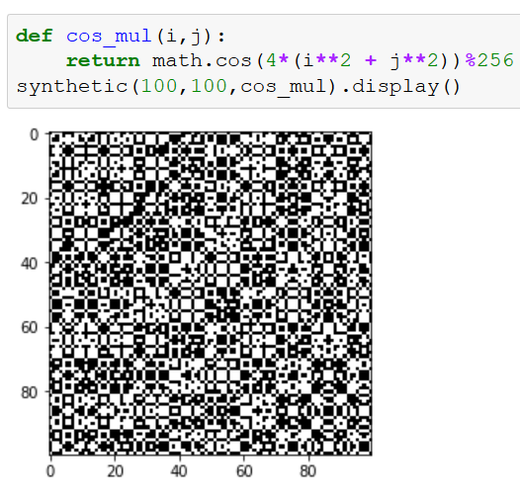
Cool patterns ☺

Slide 34
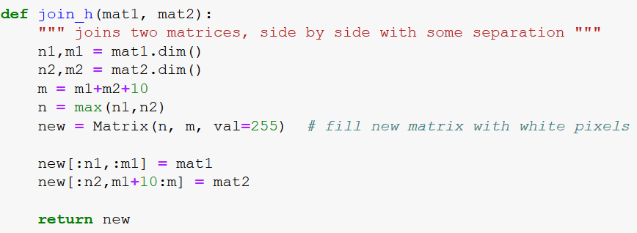
Tiling images: join horizontally

Slide 35
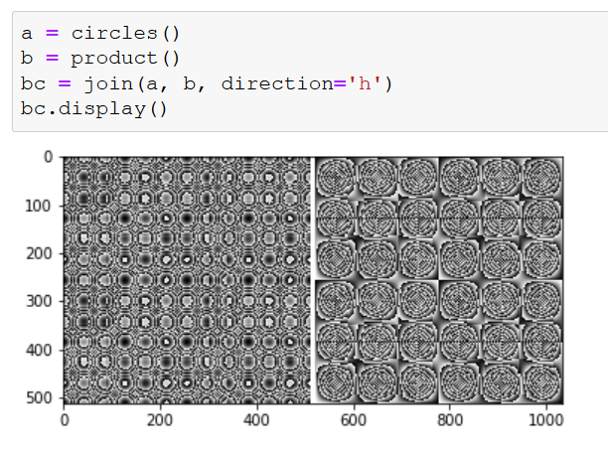
Tiling images: join horizontally

Slide 36
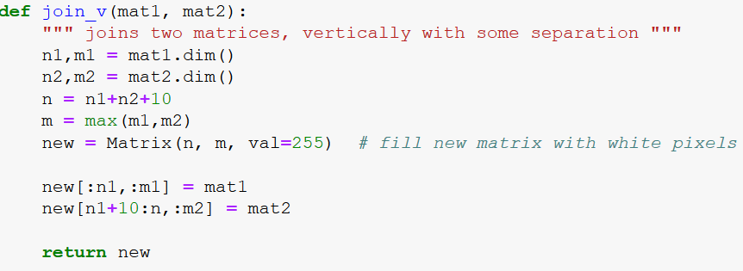
Tiling images: join vertically

Slide 37
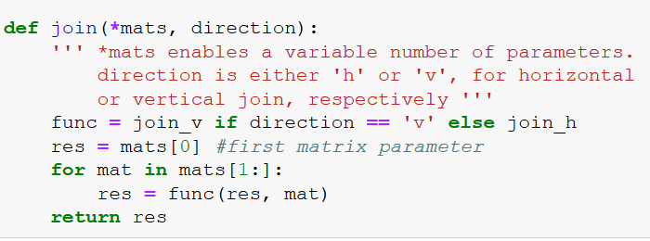
Tiling multiple images

Slide 38
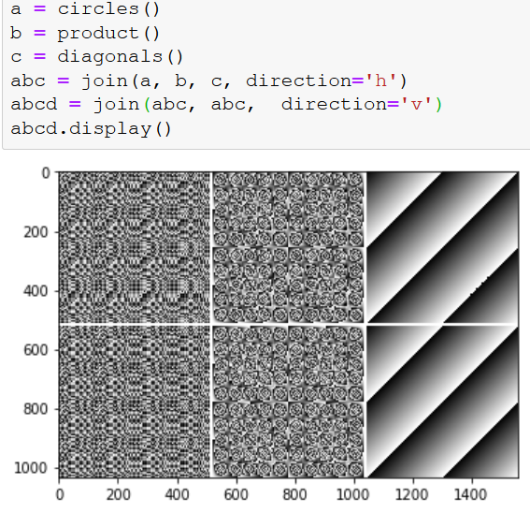
Tiling multiple images

Slide 39
Digital Image Processing

Slide 40
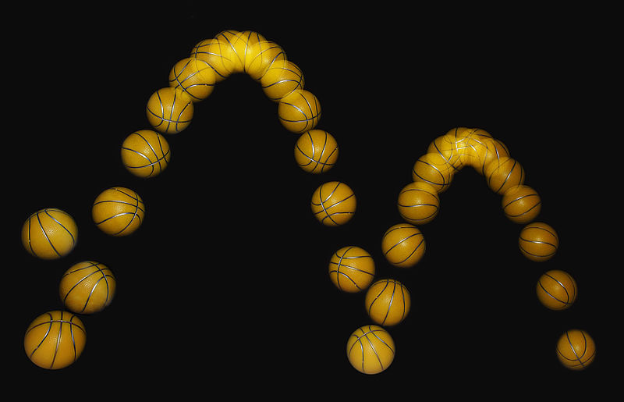
Digital Image Processing
Image processing is any form of signal processing for which the input is an image, such as a photograph or video frame; the output of image processing may be either an image or a set of characteristics or parameters related to the image. Most image-processing techniques involve treating the image as a two-dimensional signal and applying standard signal-processing techniques to it .
(text and figure taken
from Wikipedia).

Slide 41
Digital Image Processing
Signal processing for which the input is an image
Common problems:
Noise reduction (denoising) - removing noise from an image.
Segmentation - partitioning a digital image into segments (e.g. identify the boundaries of cells in a multi-cell image)
Tracking - relate objects in subsequent frames of a film
Edge detection – detecting discontinuities in the image
Registration - transforming different images into one coordinate system (e.g. minor shifts in the camera position in subsequent frames
Color correction.
Typical applications:
Machine vision
Medical / biological image analysis
Face detection
Object recognition
Augmented reality
…
41
Notes:
41

Slide 42


Blur
Blur and noise are two major effects hampering image accuracy
Blur is intrinsic to image acquisition. For example, out of focus due to camera motion or due to the optics.
Take a signal processing course (probably not in ISE) to understand more...
An original image (left) and a blurred version thereof (right). Taken from Wikipedia.

Slide 43
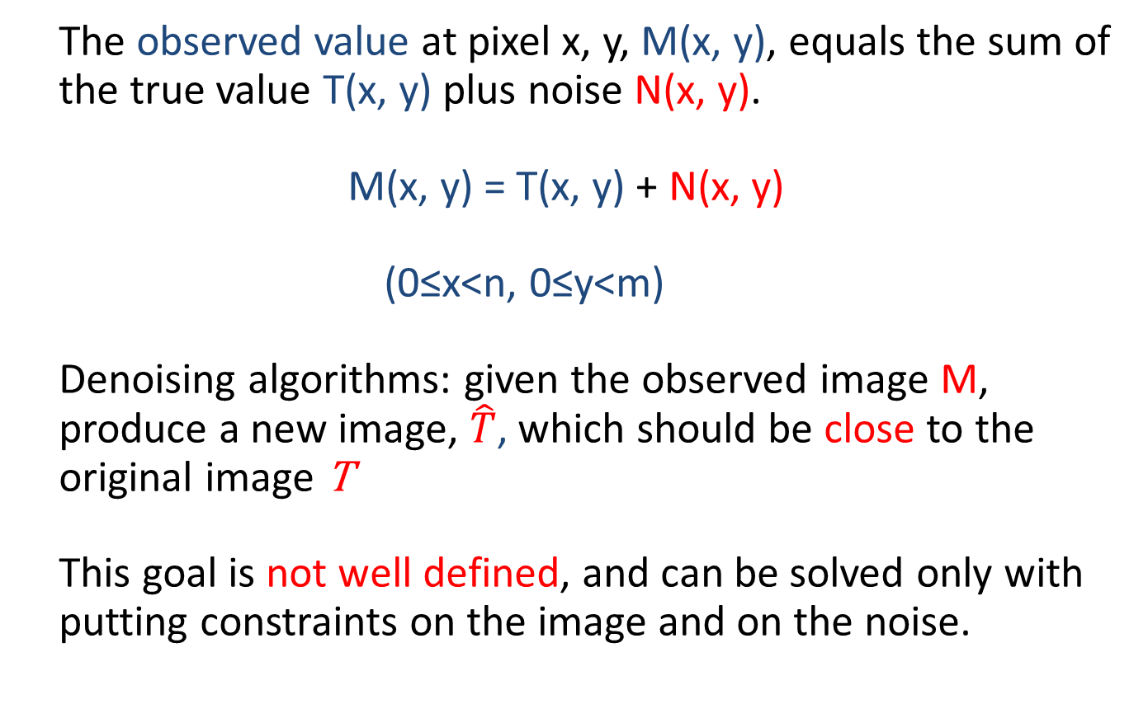
Noise and Denoising
The observed value at pixel x, y, M(x, y), equals the sum of the true value T(x, y) plus noise N(x, y).
M(x, y) = T(x, y) + N(x, y)
(0≤x<n, 0≤y<m)
Denoising algorithms: given the observed image M, produce a new image, $\hat{T}$, which should be close to the original image T
This goal is not well defined, and can be solved only with putting constraints on the image and on the noise.

Slide 44
Assumptions on the images
We assume the image is piecewise smooth: most of the image's area consists of large, smooth regions where light intensity varies continuously – if x₁, y₁ and x_{2,} y₂ are neighbors, then M[x₁,y₁] and M[x₂,y₂] attain close enough values.

Slide 45
Gaussian Noise Model
Gaussian noise model: The noise at pixel x, y, N(x, y), is a random variable.
Simplest assumption: N(x, y) is "white noise", distributed independently of the noise at other pixels..

Slide 46
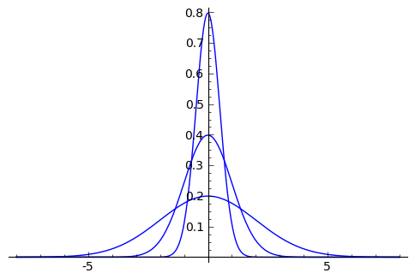
Normal (Gaussian) distribution
The probability density function
Gaussian, or normal, distribution: mean 0 and standard deviation σ.
Three Gaussians, with σ = 0.5, 1, 2 (σ = 0:5 is the narrowest).

Slide 47
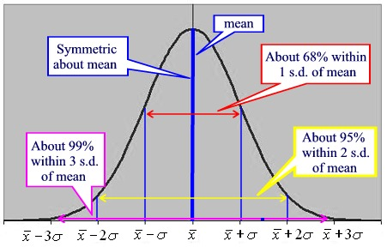
More on Normal Distributions
68% of the distribution lies within one standard deviation (std) of the mean. 95% of the distribution lies within two standard deviations of the mean. 99.7% of the distribution lies within three standard deviations of the mean.
http://www.regentsprep.org/regents/math/algtrig/ats2/normallesson.htm

Slide 48
Modeling Gaussian Noise
random.gauss(mu, sigma) returns a number distributed according to a Gaussian distribution: mean μ and std σ.
We will use μ = 0, and a default value σ = 10. When added to pixel values, we will round the noise and make sure the outcome falls within 0 to 255.
>>> import random
>>> random.gauss(0,10)
0.36121514047571907
>>> random.gauss(0,10)
21.643048694527852
>>> lst = [round(random.gauss(0,10)) for i in range(20)]
>>> lst
[-8, 22, 12, 4, -1, 2, 11, 6, -16, -1, 4, -9, -3, 1, -5, -3, 5, 18, 19, 1]
>>> sorted(lst)
[-16, -9, -8, -5, -3, -3, -1, -1, 1, 1, 2, 4, 4, 5, 6, 11, 12, 18, 19, 22]
14 out of 20 values between -10 and 10. 19 out of 20 between -20 and 20

Slide 49
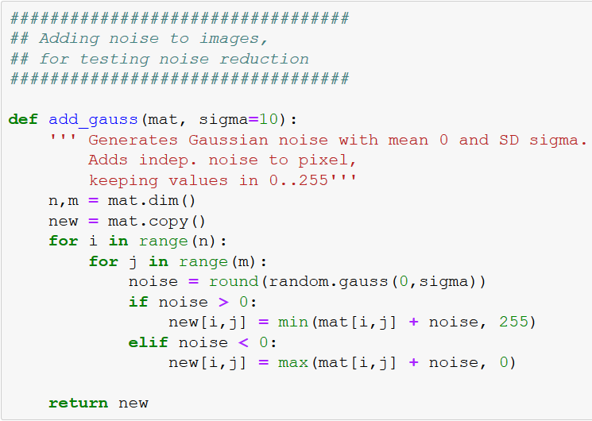
Add Gauss noise to image
To observe how Gaussian noise looks like, the following function adds such noise to a given image:

Slide 50
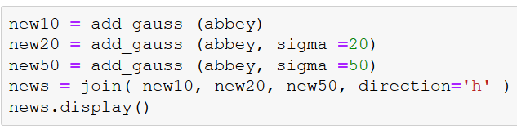
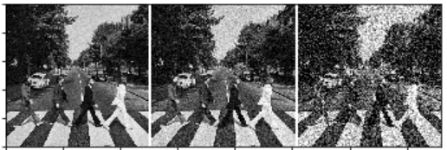
Adding Gaussian Noise to an Image: Examples
We add Gaussian noise at different levels, and show pairs of results.

Slide 51
Denoising Algorithms
We will discuss three approaches to denoising, and implement two of them:
Denoising by Local means.
Denoising by Local Medians.
Denoising by Non local means.
Of course, these three approaches are only the tip of the iceberg.

Slide 52
Local denoising
Neighborhood of the pixel x, y is defined as the set of all pixels whose coordinates are close to x, y.
A neighborhood commonly considered is the (2k+1)-by-(2k+1) square matrix of coordinates centered at x, y, where k is a small integer - typically 1 or 2.
Local denoising changes the center pixel according to some function of its neighborhood.

Slide 53
Denoising by Local Means
Replace the observed value M(x, y), by the average of the observed values in its neighborhood.
Make sure we do not modify the original matrix of observed values.

Slide 54
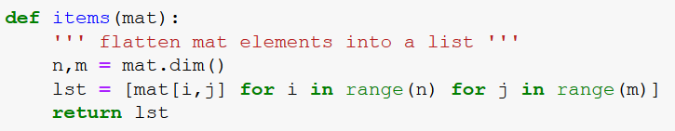
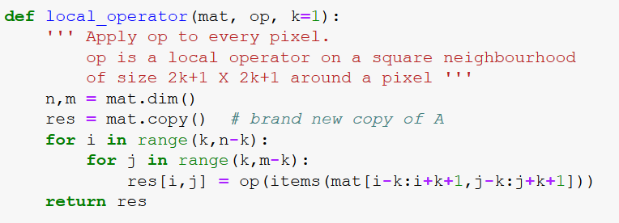
Local denoising: Auxiliary Code
items(mat) returns a list whose elements are the matrix elements.
local_operator applies op on every pixel (except the boundaries of the image: pixels not in the center of a 2k+1 by 2k+1 window are left intact.)

Slide 55

Local Means

Slide 56


Local Means: A Synthetic Example

Slide 57



Local Means: A Synthetic Example

Slide 58


Local Means: A Second Synthetic Example
averaging is highly affected by "outliers".

Slide 59
Denoising by Local Means: Motivation
If the pixel x, y resides in a smooth portion of the image, the light intensity in its neighborhood is about the same, so averaging will not change it significantly.
On the other hand, it is known that averaging (2k + 1)² independent random variables with standard deviation σ, the standard deviation of the average decreases to
which equals σ/3 for the the N_{3x3}(x, y) neighborhood.
So in smooth areas, averaging preserves the signal component of the pixel, yet substantially decreases the noise contribution.

Slide 60
Local Means: Weighted Variants
Averaging can be expressed as the matrix Frobenius inner product - sum of element by element product
A common variant puts more weight close to the central pixel. For example:
We point out that while this maintains more of the original signal, the noise reduction here is smaller.

Slide 61

Denoising by Local Means: Limitations
When the pixel x,y does not reside in a smooth portion of the image, averaging does not preserve the signal component of the image. The outcome is an image with blurred edges.
Sensitivity to spurious extreme values (a general problem with average), example: salt and pepper noise.
For example, suppose the original area of the image has intensity level of 240. Yet in the N_{3x3}(x, y) neighborhood, one pixel, e.g. x-1, y-1, is observed as very dark, e.g. intensity level around 20, due to noise.
$\hat{T}$(x-1, y-1) will be corrected to 216. Each of the other 8 pixels containing x-1, y-1 in their neighborhood, will also exhibit such "correction", which is undesirable.

Slide 62

Salt and Pepper Noise Model
A different type of noise is the so called salt and pepper noise -
extreme grey levels (white and black), or bursts, appearing at random and independently in a small number of pixels.
Original image Salt & pepper noise Gaussian noise

Slide 63

Salt and Pepper Noise: Python Code
Salt and pepper noise is not as fundamental in statistics so we'll write the code for it ourselves. The default parameter p=0.01 is the probability of a pixel being "hit" by the SP noise.

Slide 64

Adding S&P Noise to an Image: Examples

Slide 65
Denoising by Local Medians
Replace the observed value M(x, y), by the median of the observed values in a neighborhood of (x, y).
The median preserves edges (a big plus).
The median is not sensitive to spurious extreme values, so it withstands salt and pepper noise easily.
However, the median tends to eliminate small, fine features in the image, such as thin contours.
It also takes more time to compute median than mean.

Slide 66

Local Medians: Code
Median is computed by first sorting the values in the local window, and taking the middle element.

Slide 67


Local Medians: A Synthetic Example
No change !

Slide 68


Local Medians: A Second Synthetic Example
The median ignores outliers..

Slide 69
Time Complexity of Local Means and Local Medians
Suppose the image dimensions are n-by-m.
The number of windows to process: O(n∙m) (k<< m, n).
For every window, compute the average or median.
Number of pixels in a window is (2k + 1)² = 4k² + 4k + 1 = O(k²). This is the time complexity to compute the average.
For the median: sorting ➔ O(k² log k²) = O(k² log k) steps. Faster median finding exists - linear in k. Computing median can therefore be done in O(k²) steps too.
All in all, O(k²nm) steps (with better median implementation).

Slide 70
Putting Local Means/medians to the Test
Let’s test our methods
Try to decide which is better (and when)

Slide 71

Testing local means: original SP noise

Slide 72

Testing : applying local means

Slide 73

Testing : applying local medians

Slide 74

Testing with Gaussian noise: original

Slide 75

Testing with Gaussian noise: denoise

Slide 76

Segmentation
partitioning a digital image into multiple segments.
Goal: to simplify the representation for understating and \ or analysis.
Used to locate objects and boundaries (lines, curves, etc.). Usually, the first step in more complicated procedures: object recognition, shape analysis , tracking…
Examples: locating tumors in medical images; identifying objects in satellite images (roads, forests, crops, etc.).
Source:
http://www.sonycsl.co.jp/person/nielsen/applets.html

Slide 77

Binary Segmentation by Thresholding
The simplest segmentation method: apply a threshold to turn a gray-scale image into a binary image (BW)
Assumes the image contains two classes of pixels denoted foreground and background, and these two classes have distinct, different light intensities: the background is much darker than the foreground.
Can be extended to more than one threshold, creating >2 segments
Human HT29 colon-cancer cells
http://www.broadinstitute.org/bbbc/image_sets.html
Binary segmentation, threshold = 40

Slide 78


Picking a Threshold
The key is to select the appropriate threshold
Which one is the best here?
Original
When the threshold is too low (20 in this case) areas in the image where cells are densely populated become bulbs.
When it is too high (60) some cells are lost.
blubs
lost
with t=60
Threshold = 20
Threshold = 40
Threshold = 60

Slide 79

Segmentation with a Threshold– code

Slide 80




Picking a Threshold – Einstein
We want: white = Einstein, black = background
When the threshold is too low (50) we cannot separate face from background.
When it is too high (150) some areas are lost (e.g. parts of the hair), but still good.
With 100 – some noise in the background (left)
How can we pick a good threshold automatically?
Original
Threshold = 50
Threshold = 100
Threshold = 150

Slide 81

Otsu method for threshold calculation
A good threshold for segmentation:
minimizes differences within each segment, and
maximizes differences between segments.
Otsu’s method finds an optimal threshold for segmentation.
Uses image histogram: grey level values distribution.
x-axis – grey values
y-axis – number of pixels with a particular value

Slide 82

Otsu method for threshold calculation
Relies on the assumption that the foreground and the background of the image differ substantially in their brightness.
This assumption is not true in many cases, as in the Mona Lisa example.
However, when this assumption holds, there are expected to be two peaks in the gray values of an image’s histogram (bi-modal).
In this case the lowest mid-point between these two peaks would be a good choice for a threshold.
Background peak
Foreground peak
A good threshold

Slide 83


Otsu method for threshold calculation
When the difference between foreground and background are less sharp, the peaks may be partly overlapping:
When the image is rather uniform, there will be no such two peaks at all (in which case Otsu's method will be inapplicable):
A good threshold

Slide 84



Using Histograms
Threshold = 45
Threshold = 110
Good candidates: 45, 110
However, we 45 isn’t good …
Histograms do not contain all information !!

Slide 85




Thresholds with Abbey Road
Sometimes Thresholds are bad…
Here we cannot say that :
white = people, black = background
(or the other way around)
Thresholding is only good for certain types of images
Original
Threshold = 50
Threshold = 100
Threshold = 150

Slide 86

Segmenting Images with Clustering
Compressing images with color reduction /
Segmenting an image
Notes:
תשתית, פלטפורמה,

Slide 87
Clustering Image Colors
Remember KMeans?
Can be used for compression or segmentation
Main idea:
Find groups of colors that are close to each other using KMeans
Change peach pixel to its group center
Disadvantages: Not exploiting spatial information

Slide 88

Clustering Image Colors
Preliminaries:

Slide 89

Clustering Image Colors [2]
extract vals
as np array
arrange
as a col
update
colors
restore
original shape
copy to
Matrix
convert to int

Slide 90




Clustering Abbey Road
contains
most
information
Original
K=2
K=3

Slide 91
Clustering vs Thresholding
K=3
Threshold = 100
There are extension to Thresholding with > 2 classes
But Thresholding does not work for most data
Some intuition on how its really done (discussion)

Slide 92
More on Image Processing (reference only)
Edge detection
Compression, the jpg format
…

Slide 93


Edge Detection
Edge - sharp change in intensity between close pixels
Usually captures much of the meaningful information in the image
images extracted using Sobel filter from:
http://micro.magnet.fsu.edu/primer/java/digitalimaging/russ/sobelfilter/index.html

Slide 94
Compression and Image Formats
Digital images with high pixel resolution and bit depth take up lots of computer memory.
This motivates the need for compressing images.
During compression, some of the information in the image may be lost, in which case the compression is termed lossy. Otherwise, we call it lossless.
jpg, tiff, png, bmp, gif etc., differ by the type of compression applied to the original image.
The bmp format is lossless, while the other formats are lossy (tiff can be both, depending on some parameter settings).
Notes:
94

Slide 95
The example of jpg
jpg format partitions the image into squares of 8-by-8 pixels.
Most such squares will exhibit only gradual, moderate changes, especially in smooth areas of the image.
These gradual changes can be well approximated by far fewer bits than the 8·8·8 = 512 bits in the original representation.
A factor of 10 (or even more) saving in space can be achieved.
Human HT29 colon-cancer cells.
In the compressed image on the right, In the blue square all pixels are identical. In the green square, pixels only change from top to bottom. In the yellow square, pixels change in both directions.
Notes:
95

Slide 96





The Example of jpg
Human HT29 colon-cancer cells.
In the compressed image on the right, all the pixels in the blue square are identical. In the green square, pixels only change from top to bottom. In the yellow square, pixels change in both directions.
Notes:
96

